Slide 1

Project Review-2
(Literature Review / Applications Survey)
| Front-End Development Frameworks | | Title - Edu Craft – Online Course Builder with Video & Quiz Module | | Team Members – 2410030355-O.Harshitha, 2410030356-Srujana Sadhu, 2410030357-Ashrita Sri Gayatri V, 2410040126-A Sravani | |Guide - Ms P Sree Lakshmi Ma’am | Department – CSE|

Slide 2
Relevance to Project Title
Brief Explanation of Framework & Tool Choice Currently, we are working with Visual Studio Code (VS Code) as our primary development environment because it is fast, lightweight, and highly customizable. Its rich library of extensions, integrated terminal, and powerful debugging tools help us write and test code efficiently, even in the early stages of EduCraft’s development. VS Code’s flexibility also makes it easy to integrate future technologies such as React.js when we progress to building more interactive features.
In the future, we plan to adopt React.js for its component-based architecture, which will allow us to develop features like quizzes, videos, and previews as modular, reusable units. React’s virtual DOM will enable instant updates without reloading the page, delivering a smooth, responsive user experience.
Connection Between Literature Review and Project Goals The reviewed literature on e-learning platforms and front-end development highlights the importance of interactivity, modularity, and real-time responsiveness. These qualities will be implemented in EduCraft in stages — beginning with efficient coding in VS Code and later enhanced through React.js. Research shows that learners and content creators remain more engaged when updates are reflected instantly and interfaces are easily customizable. By transitioning from a VS Code-based workflow to React-powered modules, EduCraft will evolve into a smooth, adaptable, and efficient course-building platform.
Key References
VS Code Official Documentation – Guides on extensions, debugging, and integrated tools to boost productivity in EduCraft’s initial development phase.
React Official Documentation – For future integration, providing best practices for building reusable, modular components.
MDN Web Docs – JavaScript – Explains the language features that enable interactivity and real-time updates.

Slide 3
Depth & Quality of Literature Review
Name | Sponsor / Founder | Year Founded | Fees | Type
Coursera | Princeton, Stanford, UC Berkeley, Michigan, Pennsylvania | 2011 | Private (mostly paid) | Private
Khan Academy | Salman Khan (Hedge Fund Manager) | 2007 | Free | Non-profit
edX | Harvard University & MIT | 2012 | Mostly free, certificates paid | Non-profit
Udemy | Eren Bali | 2010 | Mixed (some free, mostly paid) | For-profit
Minerva | Minerva Project & Keck Graduate Institute (Larry Summers advisory board) | 2012 | Private (paid tuition) | Private

Slide 4
RESEARCH REPORT
Title of Report | Authors | Year | Focus / Summary
The Effectiveness of Online Learning: A Meta-Analysis | Barbara Means, Yukie Toyama, et al. | 2010 | Meta-analysis comparing online vs. face-to-face learning outcomes
Online Education: A Study of Academic and Social Impact | John Seely Brown & Paul Duguid | 2016 | Examines academic success and social engagement in online settings
MOOCs and Open Education Around the World | Curtis J. Bonk, Mimi M. Lee, et al. | 2015 | Explores the global impact of MOOCs and open education platforms
Student Engagement in Online Learning: What Works? | Heather Kanuka, Anthony Garrison | 2017 | Analyzes methods to improve engagement in online courses
Quality and Effectiveness of Online Education | Michael G. Moore & Greg Kearsley | 2011 | Discusses frameworks for evaluating online education quality

Slide 5
Critical Analysis, Synthesis & Gap Identification
React powers Facebook & Netflix, Angular drives Google tools, and Vue supports Alibaba & Xiaomi — e-learning giants like Udemy & Coursera use similar tech for smooth, responsive learning.
1. Critical Analysis
Existing apps (Byju’s, Vedantu, Unacademy) offer video lectures, live classes, and test series.
Strong content but low personal interaction & flexibility.
High cost → less accessible for all students.
Technical issues: Lag/crash during high traffic, needs a strong internet.
2. Synthesis
Students need more than videos – handwritten notes, doubt-solving, and collaboration.
Materials are scattered → no organized revision tools.
Minimal focus on daily learning habits & mental wellness.
3. Gap Identification
No 1-to-1 or peer learning.
Weak note management & missing smart tools (mind maps, past paper analysis).
No offline mode for low-internet areas.
Systems are not crash-proof for unlimited users.
→ Edu Craft bridges these gaps with:
Crash-proof cloud system for unlimited users.
Handwritten & rough notes, mind maps, charts, roadmaps.
AI-powered personalization + gamification.
Wellness tools (Pomodoro, mindfulness).

Slide 6
Project Implementation Started
Initial Progress
2. Frameworks, Libraries, and Tools that can be Used for further development
React - for building reusable and interactive components.
Tailwind CSS - for fast, responsive, and clean styling.
React Router - for seamless page navigation.
3. Expected Milestones for Next Review
Integrate video upload and playback functionality.
Build quiz creation and scoring logic.
Make the platform responsive for mobile and tablet devices.
Set up data storage for quizzes.
At the start of this project, our intention is to work solely using Visual Studio Code to build and refine the core structure of EduCraft. We aim to establish a strong foundation by creating the UI design and key components in a straightforward development environment. As the project evolves, we plan to transition towards using ReactJS for enhanced component-based architecture and smoother code integration. This approach will allow us to maintain modularity and scalability while ensuring efficient navigation and interaction within the application.

Slide 7
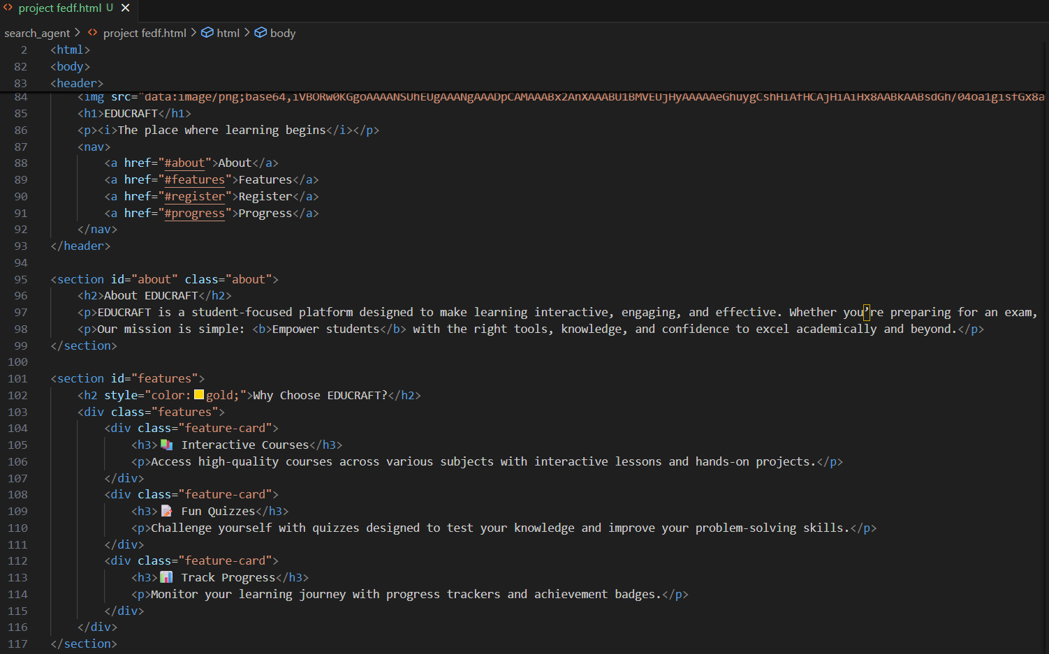
4. Screenshots / Code Snippets
http://127.0.0.1:5500/search_agent/project%20fedf.html

Slide 8
THANK YOU

